Slide 1
The Market Health Evaluation based on Zillow Research Data
Team 14 members:
Bowen Lu(10427463)
Hao Cheng(10426048)

Slide 2
Contents
Introduction
Data and Data Preparation
1. Data source
2. Raw Data
3. Data preparation
Variable Selection
1. Stepwise method
Multiple regression
1. MANOVA Table Comparison
Classification
1. Naive Bayes
2. Logistic Regression
3. Linear Discriminant Analysis
Conclusion

Slide 3
Introduction
Market Health
The Market Health Index illustrates the current health of a region’s housing market relative to other markets across the country.
Goal
Analyze the relationship between the Market Health Index and the independent variables;
Predict/Classify the market health of one or more given housing market

Slide 4
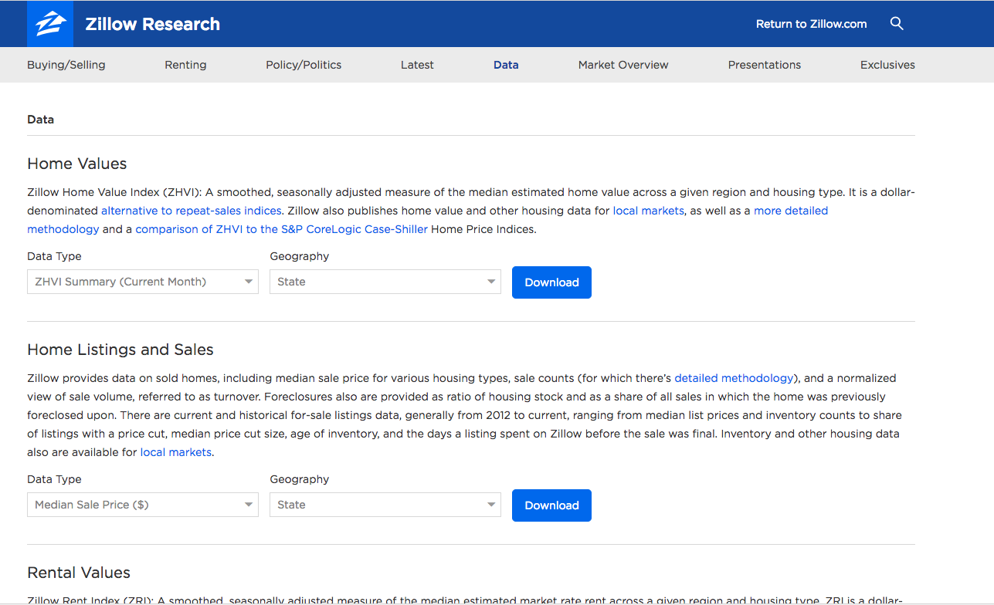
Data and Data Preparation
Data source: https://www.zillow.com/research/data/

Slide 5
Raw Data
Size: 9964 records
Dependent Variable: Market Health Index
Independent Variables
Using 17 market indicators to measure the health of markets relative to similar markets across the country.
“MoM”: month-over-month change in the Zillow Home Value Index
“YoY” : year-over-year change in ZHVI.
“SellForGain” : percentage of homes selling for a gain.
“NegativeEquity”: the percentage of mortgage holders with negative equity.
“Delinquency”: the percentage of mortgage holders delinquent on their loans.

Slide 6
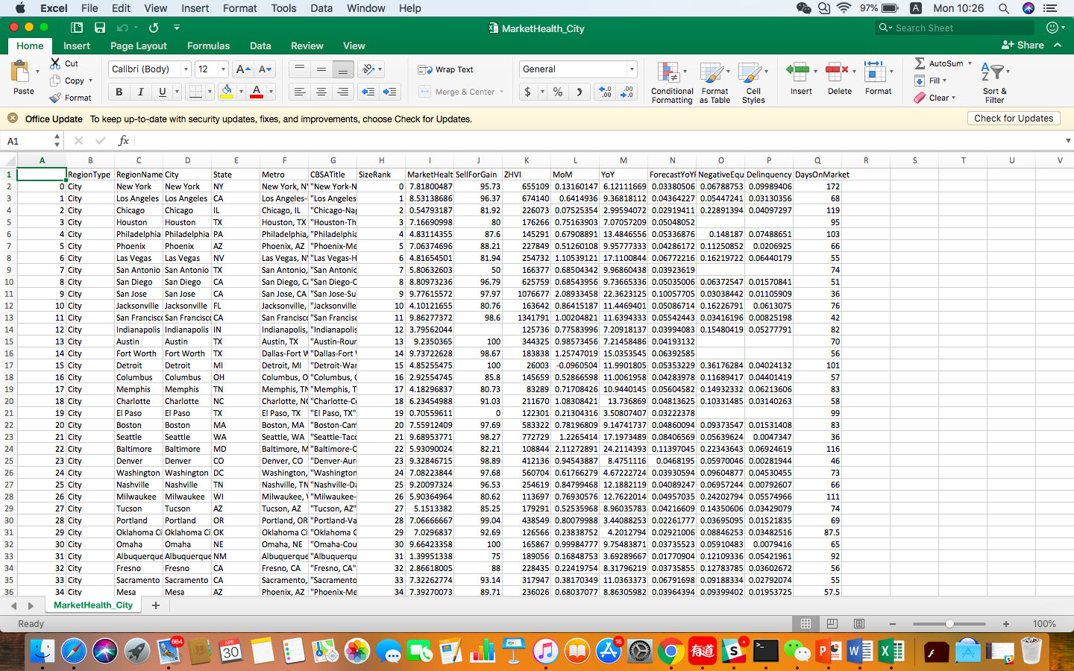
Final data

Slide 7
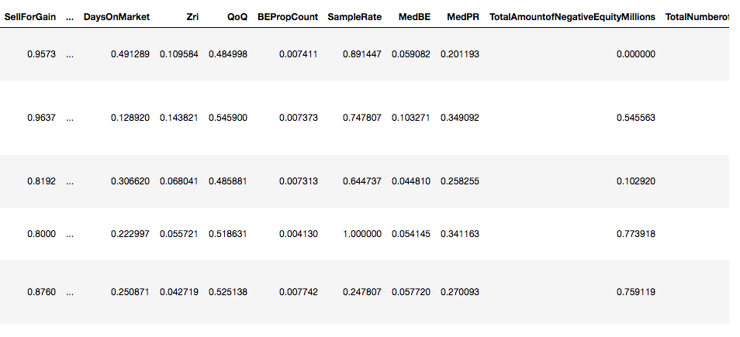
Data preparation
>50% DROP
Missing values
<50% KNN
Standardize the variables

Slide 8
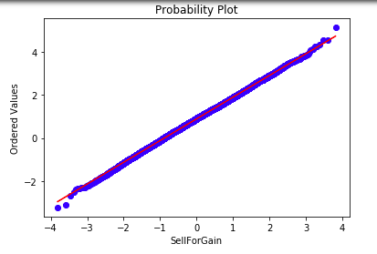
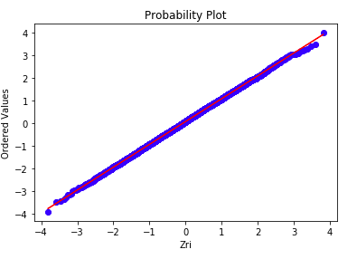
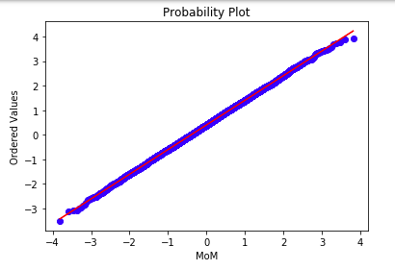
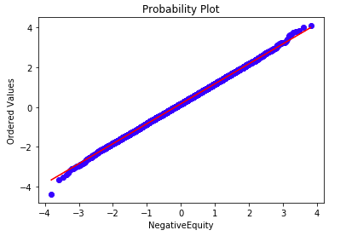
Normalization

Slide 9
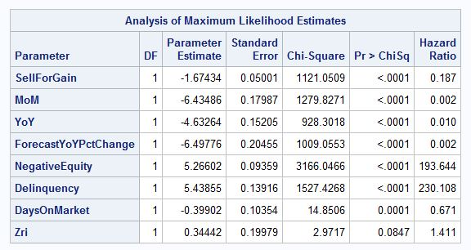
Variable Selection
Stepwise Method

Slide 10
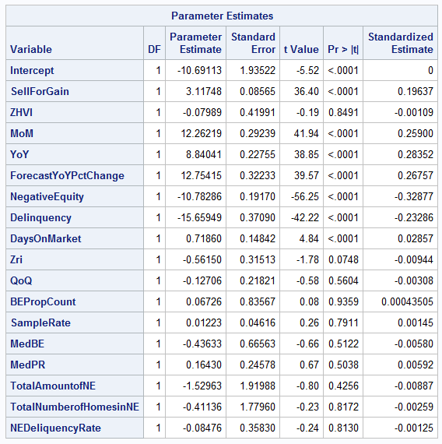
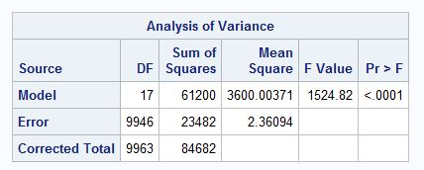
Multiple Regression
RMSE = 1.53654
R-square = 0.7227
Adj R-sq = 0.7222

Slide 11
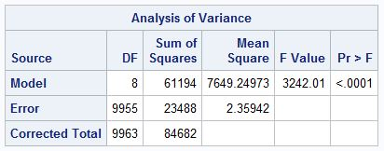
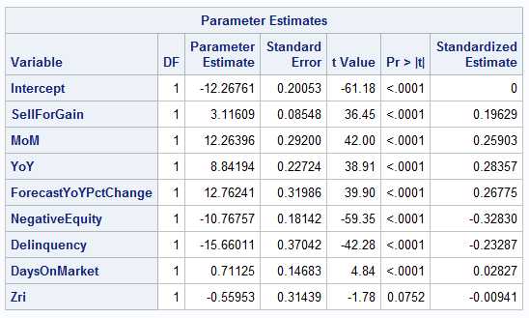
Multiple Regression
RMSE = 1.53604 ↓
R-square = 0.7226 ↓ Adj R-sq = 0.7224 ↑
MarketHealthIndex =
-12.27*Intercept+3.12*SellForGain+12.26*MoM+8.84*YoY+12.76*ForecastYoYPctChange
-10.77*NegativeEquity-15.66*Delinquency+0.71*DaysOnMarket-0.56*Zri

Slide 12
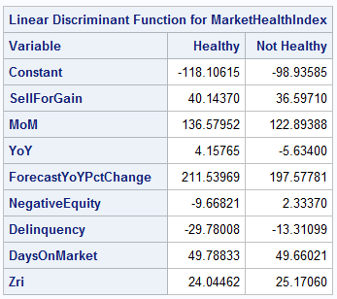
Classification
Linear Discriminant Analysis
MarketHealthIndex → binary variable (0: “Not Healthy”, 1: “Healthy”)
Prior Probability = 0.5
Hoboken
(0.8889, 0.39601617, 0.551712509, 0.557066754, 0.210198521, 0.00130719, 0.254355401, 0.069465082)
Healthy: Score=104.0719
Post Prob.=0.5022
Not Healthy: Score=104.0638
Post Prob.=0.4977

Slide 13
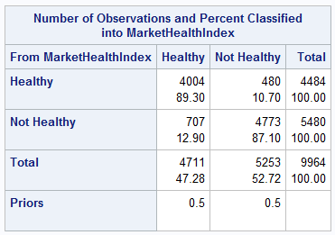



Classification
Linear Discriminant Analysis
$$\text{Precision}=\frac{\text{TP}}{\text{TP}\text{+}\text{FP}}=\frac{4004}{4484}=0.8930$$
$$\text{Recall}=\frac{\text{TP}}{\text{TP}\text{+}\text{FN}}=\frac{4004}{4711}=0.8499$$
$$\text{Fscore}=\frac{\text{2}×Precision×Recall}{\text{Precision}\text{+}\text{Recall}}=0.8709$$

Slide 14
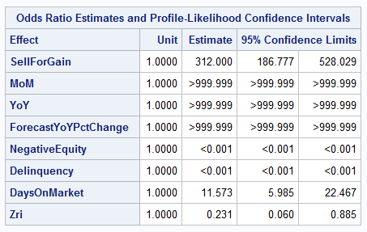
Classification
Logistic Regression
MarketHealthIndex → binary variable (0: “Not Healthy”, 1: “Healthy”)
Odds ratio

Slide 15
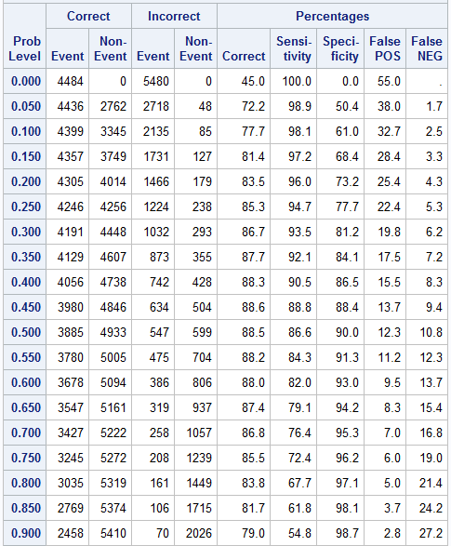
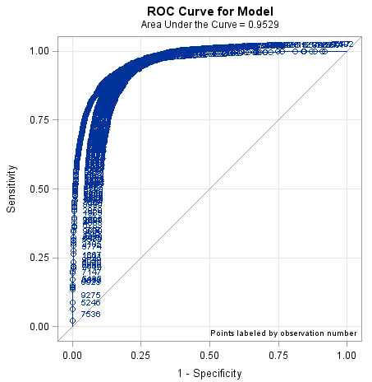

Classification
Logistic Regression

Slide 16
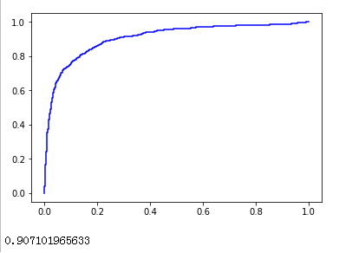
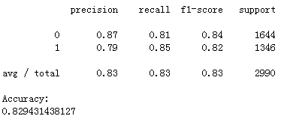
Classification
Naïve Bayes
MarketHealthIndex → binary variable (0: “Not Healthy”, 1: “Healthy”)
Bayes Theory & Independent-Event Assumption

Slide 17
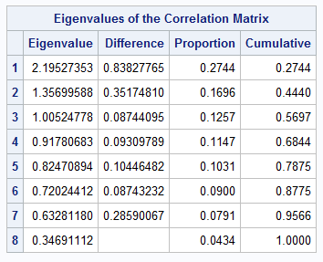
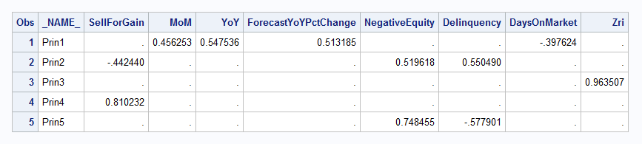
Dimension Reduction
Principle Component Analysis
Eight Independent variables → Eight Principle components

Slide 18
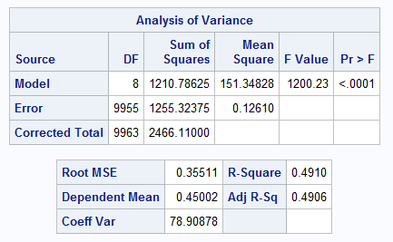
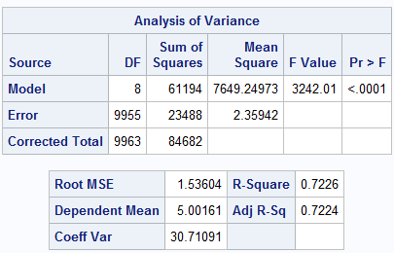
Dimension Reduction
Principle Component Analysis

Slide 19
Conclusion
As the measurement of real estate market, Market Health Index is indicated by the variables including:
{SellForGain, MoM, YoY, ForecastYoYPctChange, NegativeEquity, Delinquency, DaysOnMarket, Zri}
They can be used for generally evaluate the market health without Market Health Index
Logistic Regression has better classification accuracy, but is easy to cause overfitting;
Naïve Bayes has poorer accuracy, but less likely to cause the overfitting;

Slide 20
THANK YOU

